Slide 1
Introduction to
Marketing Research
- MANISH LAMBA

Slide 2
“It ain’t the things we don’t know that gets us in trouble. It’s the things we know that ain’t so.”
Artemus Ward

Slide 3

Marketing Research Defined
The systematic and objective process of generating information for aid in making marketing decisions

Slide 4
The Marketing Research Process
Define the Problem
Develop an Approach to the Problem
  Type of Study? Exploratory, Descriptive, Causal?
  Management & Research Questions, Hypotheses
Formulate a Research Design
  Methodology
  Questionnaire Design
Fieldwork
Prepare & Analyze the Data
Prepare & Present the Report

Slide 5

Marketing Research Types
Basic Research
Applied Research

Slide 6

Basic Research
Attempts to expand the limits of knowledge
Not directly involved in the solution to a pragmatic problem

Slide 7

Basic Research Example
Do consumers experience cognitive dissonance in low-involvement situations ?

Slide 8
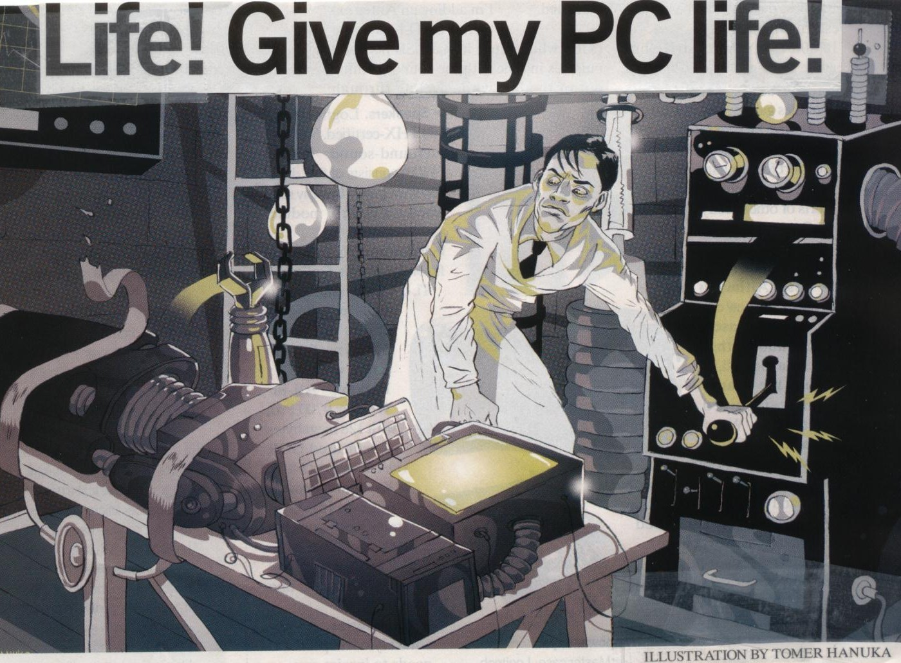
Applied Research
Conducted when a decision must be made about a specific real-life problem

Slide 9
Applied Research Example
Should McDonalds add Italian pasta dinners to its menu?
  Marketing research told McDonald’s it should not
Should Procter & Gamble add a high-priced home teeth bleaching kit to its product line?
  Research showed Crest Whitestrips would sell well at a retail price of $44

Slide 10

Scientific Method
The analysis and interpretation of empirical evidence (facts from observation or experimentation) to confirm or disprove prior conceptions

Slide 11
Using Marketing Research
We can use Marketing Research to:
  Identify & Evaluate Opportunities
  Analyze Market Segments
  Select Target Markets
  Plan & Implement Marketing Mixes
  Analyze Marketing Performance
  Performance Monitoring Research

Slide 12
Identifying and Evaluating Opportunities
Examples :
Mattel Toys investigates desires for play experiences
Home cooking is on the decline
  Purchase of pre-cooked home replacement meals is on the rise
Number of investors trading stock on the Internet is growing

Slide 13
Analyze Market Segments and Select Target Markets
Examples :
Cadillac investigates buyers’ demographic characteristics
MTV, monitoring demographic trends, learns the Hispanic audience is growing rapidly
Sears learns women, age 25-54 with average household income of $38,000, are core customers. Targets this market with "The Good Life at a Great Price. Guaranteed. Sears."

Slide 14

Plan and Implement a
Marketing Mix
Price: Safeway does a competitive pricing analysis
Distribution: Caterpillar Tractor Co. investigates dealer service program
Product: Oreo conducts taste test, Oreo cookie vs. Chips Ahoy
Promotion: How many consumers recall the “Life Tastes Good. Coca Cola!” slogan?

Slide 15
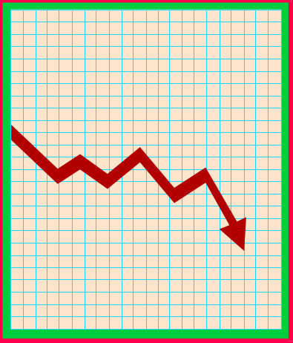
Analyze Marketing Performance
This year’s market share compared to last year’s
Did brand image change after a new advertising ?

Slide 16
Performance-Monitoring Research
Research that regularly provides feedback for evaluation and control
Indicates things are or are not going as planned
Research may be required to explain why something “went wrong”

Slide 17
Determining When to Conduct Marketing Research
Time Constraints
Availability of Data
Nature of the Decision
Benefits versus Costs

Slide 18
Determining When to Conduct Marketing Research
Time Constraints
Availability of Data
Nature of the Decision
Benefits vs. Costs
Is sufficient
time
Available ?
Information
already on
hand
Adequate ?
Is the
decision of
strategic
or tactical
importance ?
Does the
information
value
exceed the
research cost ?
Conduct
Marketing
Research
Yes
Yes
Yes
Yes
No
No
No
No
Do Not Conduct Marketing Research

Slide 19
Potential Value of a Marketing Research Effort Should Exceed Its Estimated Costs
Research expenditures
Delay of marketing decision and possible disclosure of information to rivals
Possible erroneous research results
Decreased uncertainty
Increased likelihood of correct decision
Improved marketing performance and resulting higher profits
Costs
Value

Slide 20
ALWAYS Remember
Marketing Research is a tool.
It assists marketing managers in their decision making.
IT IS NOT A REPLACEMENT FOR MANAGERIAL JUDGEMENT!!

